Slide 1
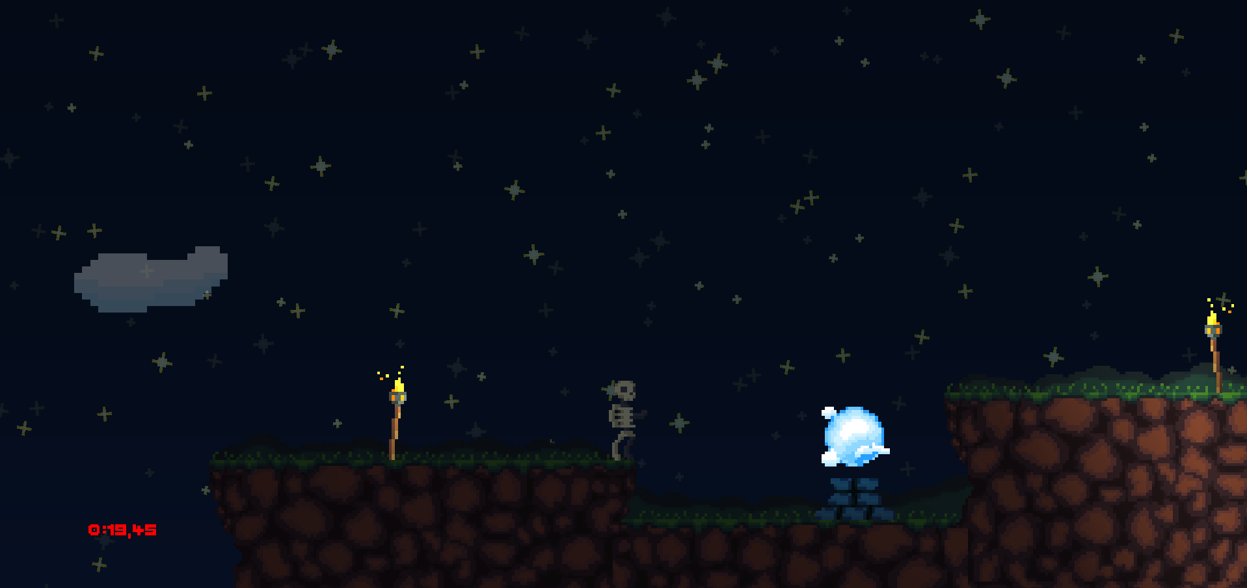
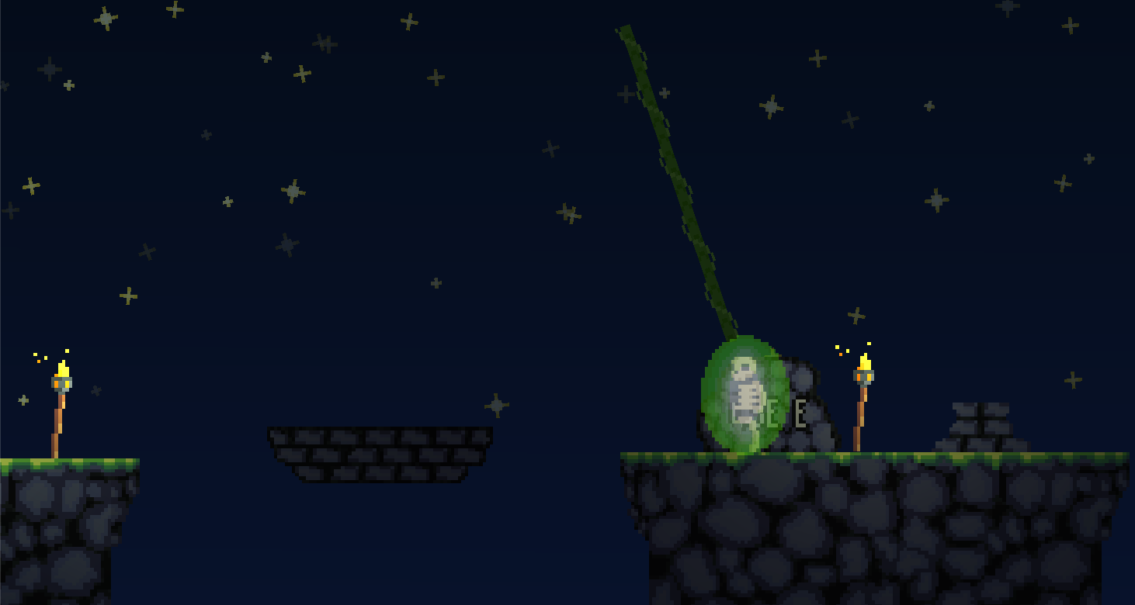



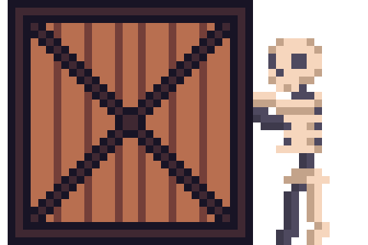
Every Level is a new Mechanic
-Unique Levels for every Orb/Ability
-Artwork and Design by our own Team
-A Framework to easily add new Mechanics

